Slide 1
An approach to quantum Bayesian inference
12th April 2019
Michael de Oliveira
Q DAYS 2019
University of Minho
Notes:
Good afternoon, I will present to you Quantum Bayesian Networks.

Slide 2
Overview
Bayesian Networks
Bayesian Networks for decision making
Quantum Inference on Bayesian Networks
Quantum Decision Making
Proof-of-concept (IBM Qiskit)
Notes:
Initially, a Bayesian Networks will be explained. Then one concrete application will be shown, which is the use of Bayesian Networks for decision making.
After that the quantum analogue will be explored, with a great focus on quantum inference. This inference will then be used to understand how decision making could be done in the quantum world. The last topic is an implementation of the presented ideas on IBM’s quantum simulator.

Slide 3
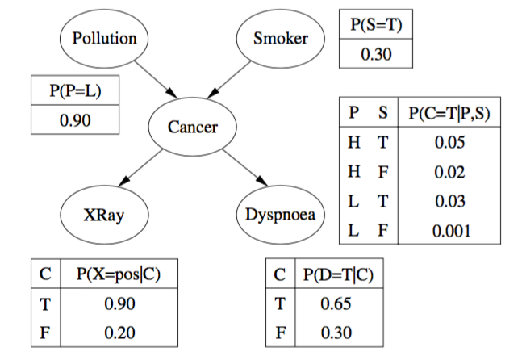
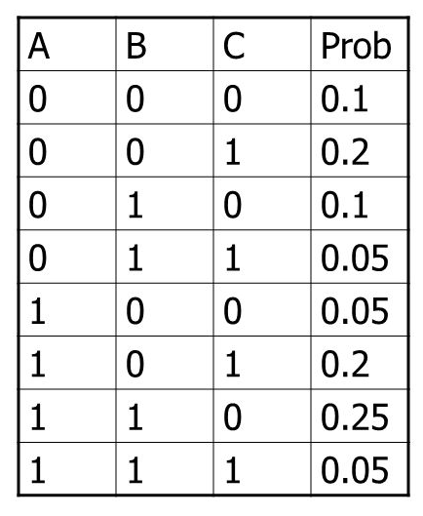
Bayesian Network
Allows a compact representation for the joint probability distribution.
The dag (directed acyclic graph) maps causal relations between the variables.
The joint probability distribution is retrieved from:
$$P\left(x_{1},…,x_{n}\right)=\prod_{i=1}^{n}{P(x_{i},Parents\left(x_{i}\right))}$$
The dimension is bounded by:
$$n2^{m}$$
n = no. of nodes
m = max (no. of parent nodes)
Bayes theorem
$$P\left(A | B\right)=\frac{P(A,B)}{P\left(B\right)}=\frac{P\left(B | A\right)∗P(A)}{P(B)}$$
Notes:
A Bayesian Network is a graphical representation of the joint probability distribution (a joint probability distribution is a table as shown in the image, this table has a probability associated to each possible configuration of the variables represented). The Bayesian Network has 2 part’s the directed acyclic graph and conditional probability tables. The graph maps the causal relations between the variables and the conditional probabilities quantify this relations. The joint probability table can be retrieved from the Bayesian Networks using the following equation. To reconstruct every entry of the joint probability table.
It is useful to use such a representation, because the dimension of the Bayesian Network is bounded a term that grows linear with the number of variables(for binary variable the term is $n2^{m}$). This is not true for the Joint probability distribution table because the number of entries grow exponentially the number of variables.

Slide 4
Exponential growth
No. Motors = 100
No. States = 10
No. Combinations = ${10}^{100}$
No. atoms in the universe ≈ ${10}^{80}$
Conclusion: to solve an uncertain task the joint probability distribution table has ${10}^{100}$ entries, (more than the amount of atoms in the universe).
Notes:
To understand why a compact representation is important. I want to present you a problem of exponential growth.
Imagine that a robot has 100 motors (the human body has more than 600 muscles), and every motor can switch between 10 different discrete states. Then there are a total of 10^100 combinations of states in which the motors can be. Now if the robot has an uncertain task to perform, there is a probability associated to each combination of states. A joint Probability Distribution table which maps this probabilities of success would have 10^100 entries. If we compare this number with the number of atoms in the known universe which is approximately 10^80, we understand that the table would have more entries that atoms in the world. Obviously, there are no memory that could save this amount of information.
But the same information could be saved efficiently be a Bayesian Network.

Slide 5
Inference
Conditional probabilities are useful for various domains, from Artificial Intelligence to Medical health care:
$P(Disease|Symptoms)$
Some arbitrary condition probability P(A|B,C) can be obtained through the Bayesian Network using:
$$P\left(A | B,C\right)=\frac{P(A,B,C)}{P(B,C)}$$
There are many algorithms to do this inference, some of them are exact and others are approximate.
$$P\left(B,C\right)=\sum_{A}{P(A,B,C)}$$
Notes:
In many uncertain domains conditional probabilities are very useful. For example, it is useful for doctor to know which is the most probable disease that the patient could have for the symptoms observed.
The conditional probability can be obtained with Bayes Theorem using joint probabilities, as we can see in the equation. In this way, conditional probability can be constructed from the Joint probability distribution tables and also from the Bayesian Network, that contains the same information.
Bayesian Networks can represent an exponential amount of information in linear space but to retrieve the joint probabilities it takes exponential time.
There are various algorithms to infer these conditional probabilities from Bayesian Networks, some are exact but require exponential time. For that reason the most algorithm´s used are approximate. The approximate algorithms require less computational resources.

Slide 6
Bayesian Networks for decision making
Bayesian Networks with utility functions can be used to make decisions.
This is possible since they allow the computation of the Expected Utility for each possible action:
$$EU\left(a | e\right)=\sum_{r}{P\left(Result=r | a,e\right)∗U(r)}$$
Subsequently, the action with the highest EU is chosen:
$$action={argmax}_{a}EU(a|e)$$
Notes:
Bayesian Network can be used to make decisions. For this task, it is necessary to have also an utility function. This utility function gives a value to every possible outcome. A very known utility function is money, because it quantifies the value of objects and services.
So from the Bayesian Network we can infer the probability of some outcome and from the utility function the value of the outcome. This 2 values combined allow us to determine which is the Expected Utility of some action. If the expected utility of all action are know, the one with the greatest Expected Utility should be chosen.

Slide 7
Bayesian Networks for decision making
For example:
The expected utility of playing in the lottery is:
$${EU}_{play1}=P\left({winning}_{1} | {play}_{1}\right)∗U\left({winning}_{1}\right)+(P\left({losing}_{1} | {play}_{1}\right)∗U({losing}_{1})$$
$${EU}_{play1}=\frac{1}{1000000}∗100000+\frac{999999}{1000000}∗0= \frac{1}{10}$$
$${EU}_{play2}=P\left({winning}_{2} | {play}_{2}\right)∗U\left({winning}_{2}\right)+(P\left({losing}_{2} | {play}_{2}\right)∗U({losing}_{2})$$
$${EU}_{play2}=\frac{2}{1000000}∗400000+\frac{999998}{1000000}∗0= \frac{8}{10}$$
The best action is to play in the lottery 2.
Notes:
For instance, if some person want´s to play in a lottery. He could determine the Expected Utility of playing in each of the lotteries and choose the one with the greatest Expected Utility.
Imagine that in the lottery 1, the probability of winning 1 in a million times and the value of the utility is the money that we win, which is 100000 euros, and the probability of not winning times the reward of not winning, which is 0, gives us the expected utility of that lottery.
After applying the same idea to lottery 2, we can know compare and decide the best lottery to play. Maximizing the reward which is money in this case.

Slide 8
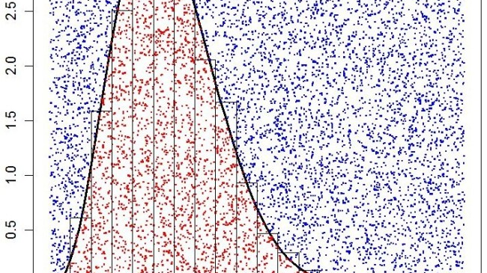
Rejection Sampling
The algorithm goes through every node and samples values for every variable.
$$<Polution,Smoker,Cancer,Xray,Dyspnoea>$$
$$<True,False,True,True,False>$$
Only the samples that have the right values for the evidence variables are used.
The answer to the query is determined by:
$$P\left(x | e\right)=\frac{Nº Samples (X=x,E=e)}{Nº Samples (E=e)}$$
$P\left(Xray=true | Smoker=true\right)= \frac{Nº Samples (Xray=true,Smoker=true)}{Nº Samples (Smoker=true)}$
Note: It is an approximate algorithm, and the precision grows with the number of samples.
Notes:
Now I will present the Rejection Sampling algorithm, that is an approximate algorithm. Rejection Sampling is not the best algorithm that exists but it is similar to the quantum version, so it is important to understand this one first. This algorithm generates samples that contain defined values for the variables. It goes through every node and samples from the probabilities given, a value for the variable.
By doing the sampling process like that , every sample is obtained with probability associated to the values defined.
To obtain a certain conditional probability, it is only necessary to dived the number of samples that verify the right values for the variable and the evidences by the samples that verify the right value for the evidences.
In concrete, if we want to know the probability of the Xray is true knowing that the person is a smoker. We would dived the number of samples with the value true for the Xray and Smoking by the samples that have the value true for smoking.
The problem associated to this algorithm is that not all samples are used. Every time that a samples has a different value for the evidence variables this sample is thrown away. This means that the number of useful samples are generated with the probability of having the evidence variables true.

Slide 9
Quantum Inference on Bayesian Networks
The Bayesian Network is encoded to a quantum state:
$$\left.|Ψ\right\rangle =\left.|Smoker,Pollution,Cancer,Xray,Dysnpoea\right\rangle$$
The probabilities of the variables are represented by superposition:
$\left.|Ψ\right\rangle =α\left.|Smoker=true\right\rangle$+$\left.β|Smoker=false\right\rangle$,
$$α^{2}=0,3 , β^{2}=0,7$$
The causal relations between the variables are mapped to the quantum state using entanglement.
Notes:
There is a quantum version for this algorithm, here the Bayesian network is encoded to a quantum state. A variable is now represented by a superposition of states. And the causal relations between the variables are mapped using entanglement between them.

Slide 10
Quantum Inference on Bayesian Networks
The circuit that encodes the Bayesian Network only needs conditional Rotations, as shown in [Low, Yoder, Chuang, 2014] (“Quantum Inference on Bayesian Networks”).
Rotations are controlled by the parent nodes.
Any observation of the state makes the wave function collapse.
The result of the observation is a sample as in the Rejection Algorithm:
$$<True,False,True,True,False>$$
Note: Building the state requires
$n2^{m}$ operations
Notes:
A circuit that encodes an Bayesian Network, only requires conditional rotations gates, as shown in in Low, Yoder, Chuang’s article “Quantum Inference on Bayesian Networks”. The Rotation is controlled by the parent nodes of the variable and the amplitude of the rotation is obtained by the Conditional Probability Table.
Every time we observe this state the wave function collapse and we obtain a sample as in the Rejection Sampling algorithm.
This algorithm is less efficient that Rejection Sampling, because every time it is necessary to reconstruct the quantum state.
But there is a different way to tackle this problem.

Slide 11
Grover’s Algorithm
Classically, a search for an element in a disordered database takes, on average, $\frac{N}{2}$ steps.
Grovers algorithm, is a quantum algorithm that performs this search in $\sqrt{N}$ of steps.
Every problem that can be reduced to a search problem, obtains a square root speed up.
Notes:
Because Grover’ s algorithm can be used. Grover’s algorithm performs a search in a disordered database with a square root speed up. For example if we are looking for an element in a disordered database it would take in mean N/2 steps to find the right element. If we perform the same seach on a quantum computer with Grover’s algorithm it would only require the sqrt(N) steps.
This means that every problem that can be reduced to a search problem, on a quantum computer with Grover’s algorithm suffers a square root speed up.

Slide 12
Quantum Inference on Bayesian Networks
Grover’s Algorithm can be applied to this quantum state. It can amplify the states where the evidences have the correct values.
$$\left.|Ψ\right\rangle =\left.\sqrt{P(e)}|Q,e\right\rangle +\sqrt{1−P(e) }\left.|Q,\overline{e}\right\rangle$$
This approach provides a square root speed up in the sampling process, because it creates the following state with a number of operations proportional to $\sqrt{\frac{1}{P(e)}}:$
$$\left.|Ψ\right\rangle =\left.|Q,e\right\rangle$$
Comparing the classical version with the quantum version:
Classical Sample $→O\left({P\left(e\right)}^{−1}\right)$
Quantum Sample $→O\left({n2^{m}P\left(e\right)}^{−\frac{1}{2}}\right)$
Note: If the Bayesian network is not too densely connected (m is small), this algorithm creates a square root speed up.
Notes:
The quantum state that encodes the Bayesian Network, can be divided in 2 states one where the evidences variables have the pretended values and a state where they have not. Grover’s algorithm can amplify the state where the evidence variables have the right value. The problem can be seen as a search where the element that we are trying to find are the states where the evidence variables are true.
This approach provides a square root speed up in the sampling process. Because after applying Grovers algorithm we are sampling from a State that generates always a useful sample.
Comparing now, the complexity of the quantum version and the classical version, the conclusion is that when the Bayesian network is not too densely connected there is a square root speed up to generate a sample.
This idea is presented in the same article about “Quantum Inference on Bayesian Networks”.

Slide 13
Quantum Decision Making
Compute the conditional probability using the quantum algorithm (square root speed up):
$$EU\left(a | e\right)=\sum_{r}{\underset{Quantum}{\underbrace{P\left(Result=r | a,e\right)}}∗\underset{Classic}{\underbrace{U(r)}}}$$
Is there a way to compute the hole decision making process in the quantum world?
We discovered that there is a way!!!
Notes:
After some research on quantum decision making, I did not found a quantum analogue to obtain the same result as in the classical version.
A simple approach to this task, is to compute the conditional probability on a quantum computer with a square root speed up and then obtain the Expected Utilities classically.
But then I asked myself if there was not a way to do the whole process on the quantum computer, and discovered what seems to be a way through.

Slide 14
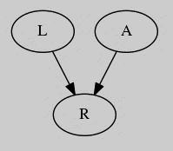
Quantum Decision Making
The Action variable is entangled with the Result variable R.
A transformation to one of them has an impact on the other too.
The utility function could be applied to R.
Notes:
As mentioned before the Action variable is entangled with the Result variable. Which means that a transformation to one of them has an impact on the other one. The idea is to apply the utility function to the Result variable, this means amplifying the states that have a greater utility, and then look to what happened to the action variable.

Slide 15
Quantum Decision Making
Do not use the Action variable as evidence variable:
$$P\left(r | evidences,a_{0}\right)$$
$$P\left(r | evidences \right)$$
The quantum state will be as following:
$$\left.|Ψ\right\rangle =γ_{1}\left.|r,a_{0},evidences\right\rangle +γ_{3}\left.|\overline{r},a_{0},evidences\right\rangle$$
+$\left.γ_{2}|r,a_{1},evidences\right\rangle +γ_{4}\left.|\overline{r},a_{1},evidences\right\rangle$
This state can be seen as a superposition of all the states necessary to obtain the succeeding conditional probabilities:
$P\left(r | a_{0},evidencies\right) , P(r|a_{1},evidences)$ , $P\left(\overline{r} | a_{0},evidencies\right) , P(\overline{r}|a_{1},evidences)$
Notes:
For that we amplify the states with the right evidences but do not define a value for the action variable, as before. This is the same process as we would try to obtain the conditional probability of P(r| evidences).
Then if we look at the quantum state created we notice that it contains a superposition of all the terms necessary to determine the Expected utilities of the actions. For example if the result variable and the action variable are binary variables , the following 4 terms are presented in the quantum state. Which before were used to obtain the following conditional probabilities.
This are all the conditional probabilities that we need to obtain the expected utilities of the actions.

Slide 16
Quantum Decision Making
Then the utility function is applied to state:
$$\left.U|Ψ\right\rangle =\frac{\sqrt{U\left(r\right)}∗α}{k}\left.|r,Actions,evidences\right\rangle +\frac{\sqrt{U\left(\overline{r}\right)}∗β}{k}\left.|\overline{r},Actions,evidences\right\rangle$$
The state can also be written with both variables defined:
$$\left.U|Ψ\right\rangle =\frac{\sqrt{U\left(r\right)}∗γ_{1}}{k´}\left.|r,a_{0},evidences\right\rangle +\frac{\sqrt{U\left(\overline{r}\right)}∗γ_{3}}{k´}\left.|\overline{r},a_{0},evidences\right\rangle$$
+$\left.\frac{\sqrt{U\left(r\right)}∗γ_{2}}{k´}|r,a_{1},evidences\right\rangle +\frac{\sqrt{U\left(\overline{r}\right)}∗γ_{4}}{k´}\left.|\overline{r},a_{1},evidences\right\rangle$
Notes:
Applying the utility function to the state as result a state with this form.
If we rewriting the same state defining also the states for the actions. We obtain 4 terms that correspond exactly to the terms that are summed up for the Expected utility of the 2 actions. The last step would be to some the terms that have the same instance for the action variable.

Slide 17
Quantum Decision Making
Now if the state is written with the Action defined:
$$\left.U|Ψ\right\rangle =\sqrt{U\left(r\right)∗γ_{1}^{2}+U\left(\overline{r}\right)∗γ_{3}^{2}}\left.|R,a_{0},evidences\right\rangle +\sqrt{U\left(r\right)γ_{2}^{2}+U\left(r\right)∗γ_{4}^{2}}\left.|R,a_{1},evidences\right\rangle$$
So, for example, the probability of sampling the action $a_{0}$ is:
$P\left(a_{0}\right)=$ $U\left(r\right)∗γ_{1}^{2}+U\left(\overline{r}\right)∗γ_{3}^{2}$
= $U\left(r\right)∗P(a_{0},r,e)+U\left(\overline{r}\right)∗P(a_{0},\overline{r},e)$
This means that the probability of sampling some action is proportional to its Expected Utility:
$$P\left(a_{0}\right)∝EU\left(a_{0}\right)$$
$$γ_{1}^{2}=P(a_{0},r,e)$$
$$P\left(a_{0},r,e\right)∝P(r|a_{0},e)$$
Notes:
If we write the same state only defining the action variable we obtained exactly that some.
At this point, we can see that the probability of sampling some action proportional to there Expected utility.

Slide 18
Quantum Decision Making
If the value of$κ_{n}$ is equal for all actions, then the action with the greatest probability is also the action with the greatest Expected Utility.
$$P\left(a_{n}\right)∝EU\left(a_{n}\right)$$
$$P\left(a_{n}\right)∗ κ_{n}=EU\left(a_{n}\right)$$
It is true if the state of the actions begins in a perfect superposition, this means that all states have the same probability.
This condition makes sense for the problem, the agent should not be biased to choose some action without any reason.
Notes:
Now if the value of the proportionality constant, kn, is equal for all instances of the action variable. We can compare the Expected Utilities of some actions by their probabilities. This would mean that the action with the greatest probability would be the action with the greatest Expected utility. Which is the action that we are searching for.

Slide 19
Quantum Decision Making
At this point, only some samples are necessary to certify which is the action with the greatest probability/utility.
It is no more necessary to obtain conditional probabilities.
The result has a higher precision because no errors are accumulating:
$EU\left(a | e\right)=\sum_{r}{\left(P\left(Result=r | a,e\right)+∆\right)∗U\left(r\right), }$
$$∆=error term$$
Notes:
At this point, only some samples are necessary to certify which is the action with the greatest probability/utility. Also there is no need to obtained conditional probabilities any more and the precision of the result grows. The precision grows because in the previous method, every conditional probability would have an error, and this errors would accumulate for the Expected Utility.

Slide 20
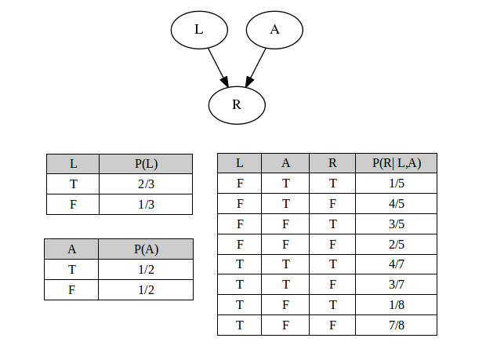
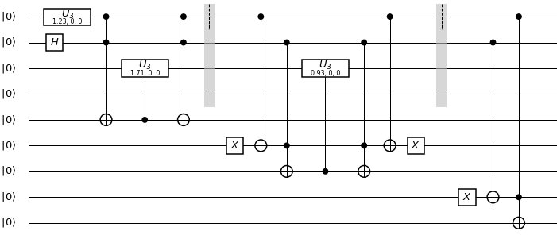
Proof-of-concept (IBM Qiskit)
This idea was implemented on IBM´s quantum simulator.
A very simples Bayesian Networks was encoded.
Grover's algorithm was implemented and the utility function applied.
Notes:
This idea was implemented on IBM´s quantum simulator, in the figure we can see the Bayesian Network that was encoded. It´s the most simple Network that could be used to verify the idea, to keep it simple. The other figure represents the circuit that encodes the Bayesian Network to the quantum state. The next step is to apply the Grover’s algorithm and the Utility function.

Slide 21
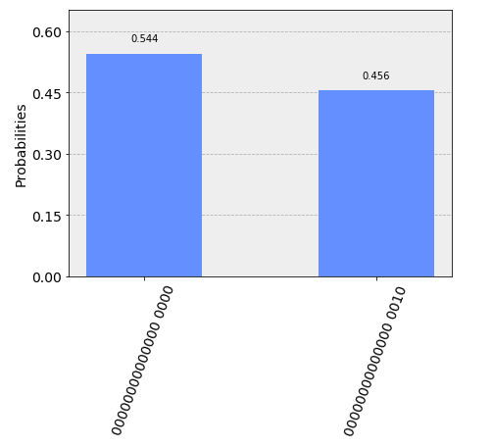
Proof-of-concept (IBM Qiskit)
For the utility function selected, the probabilities for the actions should be $P\left(a_{0}\right)=0,58$ and $P\left(a_{1}\right)=0,42$.
The expected result is between the error gap.
There is no difficulty in choosing the best action to take.
Notes:
For the utility function selected, theoretically the probabilities, for action_0 would be 0,58 and 0,42 for action_1.
As we can see in the figure the values are not perfect but they are in between the error gap. This error gap exists because Grover’s algorithm is probabilistic and the number of iterations in Grover´s algorithm must be an integer, so for some states we only obtain the right state with a probability smaller than 99%.
The error in this case is not a problem there is no difficulty to chose the best action correctly.

Slide 22
Conclusion and Future Work
This process is efficient and can be easily implemented.
Add Online and/or Active learning processes.
Notes:
I conclude that process is efficient and can be easily implemented.
As future work I am seeking for a a way to reduce the number of samples necessary, maybe find an algorithm that amplifies the state with the most probability.
Another interesting topic is to understand to what extent the complexity is indeed reduced.

